Slide 1


Agile Estimation
Session 4
March 2015
This document is confidential and contains proprietary information, including trade secrets of CitiusTech. Neither the document nor any of the information contained in it may be reproduced or disclosed to any unauthorized person under any circumstances without the express written permission of CitiusTech.
Notes:
http://www.istockphoto.com/photo/healthcare-and-medicine-22075110?st=3e3101d
http://www.istockphoto.com/photo/laboratory-42696182?st=3e3101d

Slide 2
Agenda
What is Estimation?
Why do we Estimate?
Why Estimation Fails?
What to Estimate?
Estimation Techniques
Definition of Done
Estimate Best Practice

Slide 3

What is Estimation?
Estimation is the process of finding an estimate, or approximation, which is a value that is usable for some purpose even if input data may be incomplete, uncertain, or unstable.
The value is nonetheless usable because it is derived from the best information available.
Typically, estimation involves "using the value of a statistic derived from a sample to estimate the value of a corresponding population parameter".

Slide 4
Agenda
What is Estimation?
Why do we Estimate?
Why Estimation Fails?
What to Estimate?
Estimation Techniques
Definition of Done
Estimate Best Practice

Slide 5


Why do we Estimate?
Schedule
Reliable project delivery dates .
Reducing Uncertainty
Align the business objectives and technical estimates .
Cost
Controlled project costs.
Customer Satisfaction
Better informed business decision making .
Improved communication between management and the project team

Slide 6
Agenda
What is Estimation?
Why do we Estimate?
Why Estimation Fails?
What to Estimate?
Estimation Techniques
Definition of Done
Estimate Best Practice

Slide 7
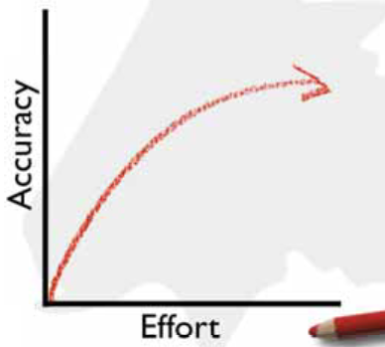
Why Estimation Fails?
Estimation is one of the harder parts of a software Project.
Some data:
Nearly ⅔ of projects significantly overrun their cost estimates.
64% of the features included in products are rarely or never used.
The average project exceeds its schedule by 100%.
Focused in features and not in activities.
A little efforts helps a lot
A lot of effort only helps a little more
Key Reasons
Activities don’t finish early.
Lateness is passed down the schedule.
Activities are not independent .
Featured are not developed by priority.
We ignore Uncertainty.
Estimates become commitments.

Slide 8
Agenda
What is Estimation?
Why do we Estimate?
Why Estimation Fails?
What to Estimate?
Estimation Techniques
Definition of Done
Estimate Best Practice

Slide 9
What to Estimate?
Estimate size; derive duration
velocity
Desired features
User stories
Estimate iterations
Derive duration
Estimate size
schedule

Slide 10


Use Relative Measure of Size
Lines of Code
Function Point
Story Points
Ideal Days
Traditional Measures
Agile Measures

Slide 11
Story Points
The “bigness” of a task
Influenced by
How hard it is
How much of it there is
Relative values are what is important:
A login screen is a 2.
A search feature is an 8.
Points are unit-less
Med
Easy
Hard
Impossible
Crazy
Next to Impossible
Easy
Ok
Please no

Slide 12
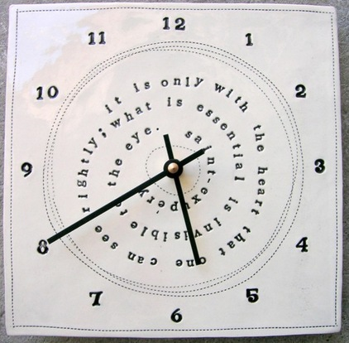
Ideal Time
How long something would take if
It’s all you worked on
You had no interruptions
and everything you need is available
It’s easier to estimate in ideal time
It’s too hard to estimate directly in elapsed time
Need to consider all the factors that affect elapsed time at the same time you’re estimating

Slide 13
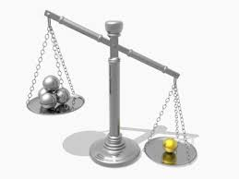
Comparing the Approaches
Story points help drive cross-functional behavior
Story point estimates do not decay
Story points are a pure measure of size
Estimating in story points is typically faster
My ideal days cannot be added to your ideal days
Ideal days are easier to explain outside the team
Ideal days are easier to estimate at first

Slide 14
Agenda
What is Estimation?
Why do we Estimate?
Why Estimation Fails?
What to Estimate?
Estimation Techniques
Definition of Done
Estimate Best Practice

Slide 15
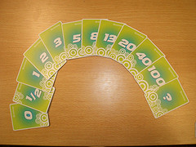
Estimation Techniques
The three most common techniques for estimating are
Expert opinion
Analogy
Disaggregation
Each of these techniques may be used on its own, but the techniques should be combined for best results.

Slide 16

Estimation Techniques : Expert Opinion
If you want to know how long something is likely to take, ask an expert.
Advantages:
It usually doesn’t take very long.
Disadvantages:
On an agile project, estimates are assigned to user stories or other user valued functionality.
Developing this functionality is likely to require a variety of skills normally performed by more than one person.
This makes it difficult to find suitable experts who can assess the effort across all disciplines.

Slide 17

Estimation Techniques : Analogy
When estimating by analogy, the estimator compares the story being estimated with one or more other stories.
If the story is twice the size, it is given an estimate twice as large.
When estimating this way, you do not compare all stories against a single baseline or universal reference.
Instead, you want to estimate each new story against an assortment of those that have already been estimated.
To decide if a story should be estimated at five story points, see if it seems a little bigger than a story you estimated at three and a little smaller than a story you estimated at eight.

Slide 18

Estimation Techniques : Disaggregation
Disaggregation refers to splitting a story or feature into smaller, easier-to-estimate pieces.
However, you need to be careful not to go too far with this approach.

Slide 19

Factors Affecting Estimations
The agility of the client organization
Team maturity
The mutual trust between the client and the offshore team
Familiarity of domain and technical context

Slide 20
Agenda
What is Estimation?
Why do we Estimate?
Why Estimation Fails?
What to Estimate?
Estimation Techniques
Definition of Done
Estimate Best Practice

Slide 21
Definition of “Done”
Get this completed from Amit K

Slide 22
What if an estimate is large?
Break down stories as they move up the backlog
Ready for Iteration planning
Increasing detail
Increasing priority
Mid-range (4-10 iterations out
Long-term (10+ iterations out)

Slide 23

Relativity
Scrum work on the theory of Relativity for Estimate
Relative | Absolute
Story points | Hours/Days
Used for Release planning | Used for Sprint planning
Accuracy is not important | Accuracy is important to some extend
Eliminates bias | Does not eliminate bias
Cannot be compared with another team’s | Supports comparison

Slide 24
Making it Abstract - Story Points
Used to estimate the size of a story: the effort of a requirement
Relative estimation - 2 story points require more effort than one story point and 13 story points require much more effort than 1 story point
Attention to complexity: inherent and accidental
1 2 3 5 8 13
Sprint Planning
1 2 3 5 8 13 21 80 100 ...

Slide 25
Agenda
What is Estimation?
Why do we Estimate?
Why Estimation Fails?
What to Estimate?
Estimation Techniques
Definition of Done
Estimate Best Practice

Slide 26
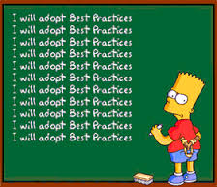
Best Practices
Use more than one person
Use more than one approach
Agree on what “It” and “Done” means
Know when to stop
Present estimates as a range
Defend / explain estimate range probabilities
Don’t reserve estimating for when you know least about the project
Be aware of common estimation omissions
Embrace reality early
Review, Revisit, Remove head from sand, Repeat

Slide 27
Summary
Don’t forget an estimate is only an estimate.
The better you are at it, the better you will be at hitting deadlines and protecting quality.
Estimate size; derive duration
Size
Calculation
Duration
300
Kilograms
Velocity=20
300/20=15 iterations

Slide 28
References
Book - Fallacies of Agile Development by Venkat Subramaniam
Book - Practices of an Agile Developer by Venkat Subramaniam and Andy Hunt

Slide 29
Thank You

